Slide 1
Portfolio
Student portfolio

Slide 2
About me:
Name: A. Bharathi
Course: B.Sc. Computer science
College Name : Valliammai Women’s College of Arts and Science
Email : bharathi200723@gmail.com
Phone no : 9043031363

Slide 3
Table of the contents :
Self introduction
Academic information
Skills
Achievement
Extracurricular activities
Personal Details
Conclusion

Slide 4
Self Introduction :
My name is Bharathi Arumugam, studying second year computer science student with a passion for programming, web development, and problem solving, I believe in continuous learning and wish contributed to the IT industry by creating efficient and user friendly software application. My career goal is become a web developer and work on innovative technology projects.

Slide 5
Academic Information :
B.Sc. Computer science
2024_2027(Valliammai Women’s College of Arts and Science )=75%
• Higher Secondary
2022_2024(Government of higher secondary school)=80%
2021_2022(Government of higher secondary school )=67%

Slide 6
Skills :
Programming language Python, C++
Web development : HTML, CSS, JavaScript
MS Office, Photo Shop
Communication and Presentation
Time management
Problem Solving
Leadership and Project management

Slide 7
Achievement :
Received merit schorlarship for scoring above 73% in all semester

Slide 8
Extracurricular Activities :
Creative pursuit : Arts, Music, Writing Quotes other activities
Sports :Kapadi , Tennis, Team work and individual sports

Slide 9
Personal Details :
I’m born in 23th January in 2007
Father name : Arumugam
Mother name : Sumathi
Languages known : Tamil and English
Hobbies : Reading stories, writing, Playing games

Slide 10
Conclusion :
“ I am an enthusiastic learner with strong technical and communication skills. My future aspirations is to work in a reputed IT company as a software engineer and later purse higher studies in artificial intelligence. I an confident that my skills, projects, and dedication with help me achieve my goals “.

Slide 11
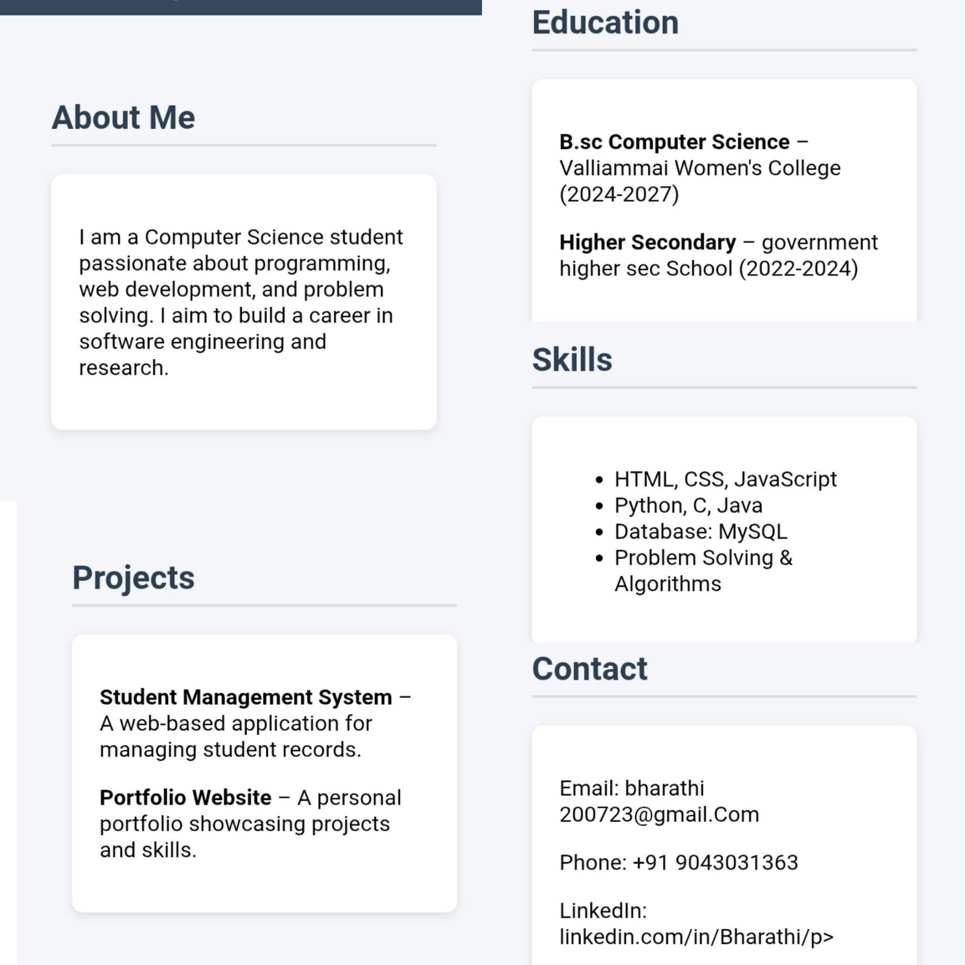

Slide 12
Githup :
https://github.com/bharathi200723-commits/Bharathi-

Slide 13
End of the presentation
Thank you

